Slide 1

AutoLingo
An AI-Powered Smart Text Autocomplete Engine Designed for Context-Aware Sequential Text Generation

Slide 2


The Problem & Solution
Context-Awareness: Modern apps require fast, intelligent autocomplete to maximize user typing speed and experience.
Data Bottleneck: Real-world text (e.g., raw web scraping) is inherently noisy and unstructured, hindering model learning.
High Costs: Manual data labeling for training deep learning models is highly resource-intensive and expensive.
The AutoLingo Solution: An end-to-end pipeline handling everything from automated data cleaning to real-time model inference.

Slide 3






Evolution of NLP Models
Traditional Models
Classical ML
Deep Learning
Early autocomplete systems relied heavily on N-gram models and statistical frequencies, which severely struggle with understanding long-range context.
Algorithms like KNN and Decision Trees can be adapted for text classification but frequently face the 'curse of dimensionality' with sparse text data.
Dense embeddings and neural architectures (PyTorch Linear Models, Transformers) have revolutionized NLP by capturing complex semantic relationships.

Slide 4



Identifying Research Gaps
Data Bottlenecks
Holistic Benchmarking
Resource Forecasting
There is a distinct lack of accessible, automated semi-supervised data cleaning pipelines tailored for building bespoke autocomplete engines without annotation overhead.
Limited platforms offer direct, side-by-side comparisons of deep learning models versus traditional ML baselines (Random Forest, KNN) in real-time text generation.
Difficulty remains in accurately predicting a model's training latency and validation loss based on architectural hyperparameters prior to committing compute resources.

Slide 5
End-to-End System Architecture
2. Core ML
4. Deployment
Cleaned data flows into parallel training tracks: PyTorch TextPredictor versus Classical scikit-learn classifiers.
A FastAPI backend serves trained models to an interactive Web UI for real-time user validation.
1. Ingestion
3. Benchmarking
Raw text is processed, and semi-supervised Label Propagation filters out junk to yield a pristine corpus.
Outputs are thoroughly evaluated, and Polynomial Regression models are fitted to forecast performance latency.

Slide 6


Core ML Engines
PyTorch Neural Network
Traditional ML Baselines
Utilizes dense position embeddings coupled with hidden linear transformation layers.
Context sliding windows are strictly encoded as flat, sparse one-hot vectors.
Optimized via Cross-Entropy Loss to maximize precise sequential character prediction.
Leverages standard robust scikit-learn baseline classifiers for comparison.
Employs the highly efficient AdamW optimizer for rapid and stable model convergence.
Evaluates established algorithms including KNN, Decision Trees, and Logistic Regression.

Slide 7


Support Systems
Data Sanitizer
Character-level n-gram frequency matrices are combined with Label Propagation algorithms to automatically classify raw sentences as high-quality or noise.
Performance Regressor
Linear and Polynomial Regression models are dynamically trained on historical system logs to accurately forecast execution time based on hyperparameters.

Slide 8




System Performance Results
Superior Context-Awareness The PyTorch Embedding-to-Linear model consistently demonstrated superior context understanding and lower Cross-Entropy loss over all traditional ML baselines.
Impact of Data Quality Implementing Tri-Training and Label Propagation successfully heightened the signal-to-noise ratio in the corpus, directly leading to much faster model convergence.
Accurate Forecasting The Polynomial Regression forecaster accurately predicted training latency for scaled model sizes, allowing for highly optimized hyperparameter tuning routines.
Real-Time API Execution The deployed dashboard handles concurrent prediction requests seamlessly, visually contrasting neural predictions against classical outputs in real-time.

Slide 9




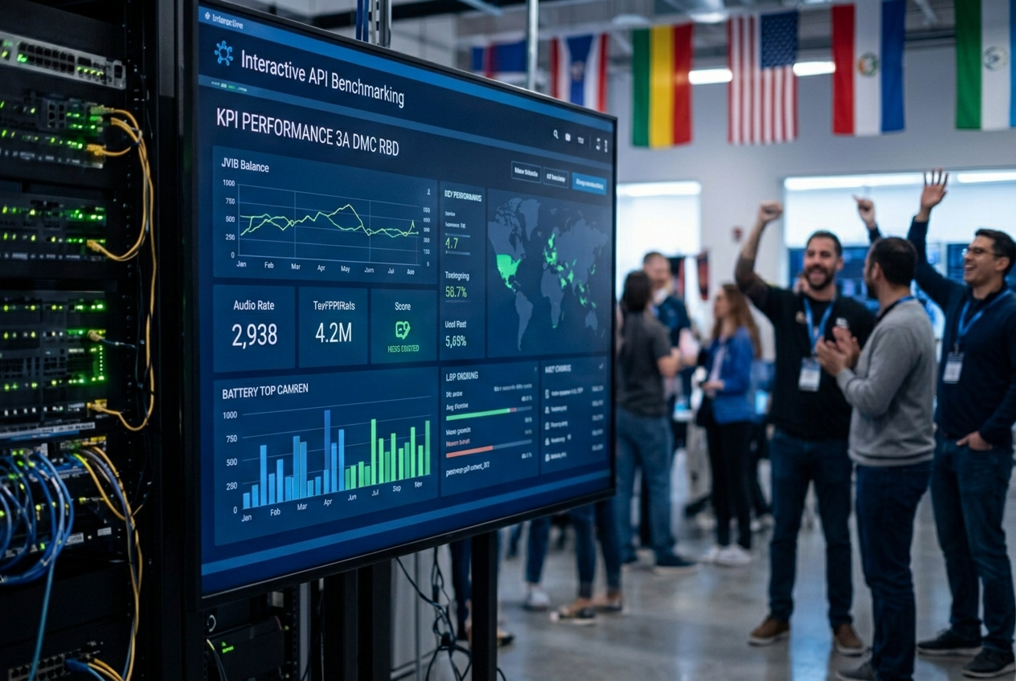
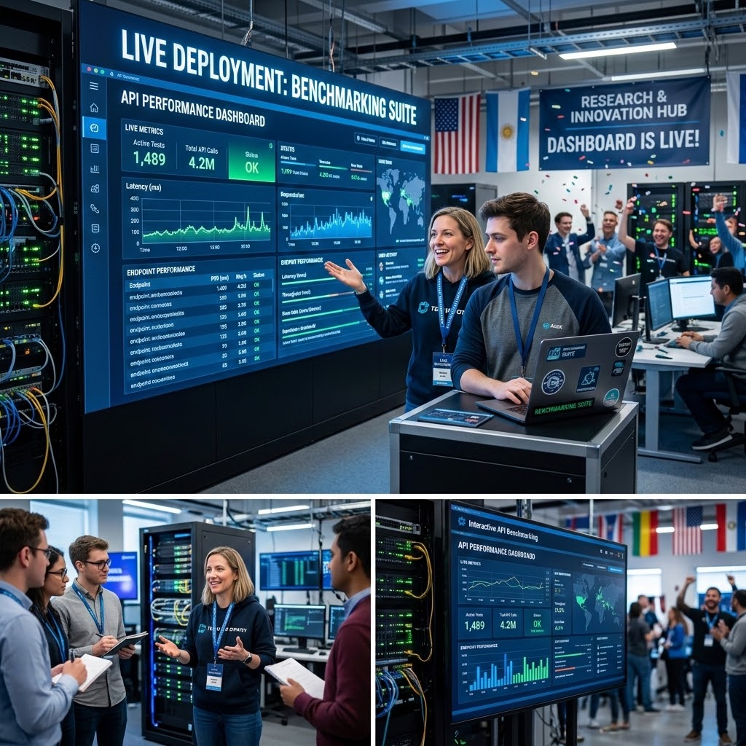
Project Conclusion
Automated Pipeline
Neural Superiority
Live Deployment
Successfully automated the notoriously tedious data cleaning process using advanced semi-supervised learning techniques.
Clearly demonstrated that deep neural embedding approaches yield vastly more cohesive and logical autocomplete suggestions.
Built a comprehensive benchmarking suite, culminating in a live, interactive API dashboard that brings the research to life.

Slide 10



Future Scope
Architectural Upgrades
Tokenization Advances
Cloud Deployment
Transitioning the core engine to incorporate full Transformer Blocks (Attention mechanisms) to vastly improve long-term context retention.
Shifting from character-level prediction to sub-word (BPE) or word-level tokenization for significantly faster inference and vocabulary handling.
Containerizing the ecosystem with Docker and migrating deployment to scalable cloud infrastructure (AWS/GCP) to enable global load balancing.

Slide 11
References
1. PyTorch Documentation for Deep Learning Frameworks and Architectures.
2. Scikit-Learn: Machine Learning in Python (Pedregosa et al., 2011).
3. Learning from labeled and unlabeled data with label propagation. (Xiaojin Zhu and Zoubin Ghahramani, 2002).
4. Tri-training: Exploiting unlabeled data using three classifiers. (Zhi-Hua Zhou and Ming Li, IEEE Transactions on Knowledge and Data Engineering, 2005).

Slide 12





Image Sources
https://images.splitshire.com/full/The-Backside-View-of-a-Man-Using-Laptop_8R1x6.png
Source: www.splitshire.com
https://images.presentationgo.com/2025/04/abstract-neural-network-background.png
Source: www.presentationgo.com
https://media.easy-peasy.ai/bfd831df-caa3-4570-9a36-244747e25de9/dc908460-298d-4824-833e-31eb551f071e_medium.webp
Source: easy-peasy.ai
https://images.stockcake.com/public/a/7/1/a7132125-dcf1-49e0-b242-5369620ae1cb_large/digital-brain-concept-stockcake.jpg
Source: stockcake.com
https://www.codester.com/static/uploads/items/000/056/56392/preview.jpg
Source: www.codester.com

